Slide 1



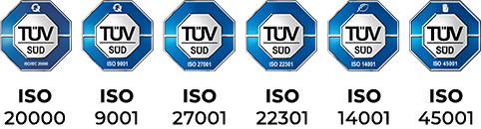

Flutter Introduction
Tomáš IVAN
May, 2024

Slide 2




Content
Q&A:
Join at slido.com
#1162 852
Intro
Beginning
Settings
Something more

Slide 3


Introduction - Who am I?
IT enthusiast that love to write code, try new things and share knowledge. If not sitting in front of the computer, then I am spending time with my family, playing board games, riding xor just drinking beer in my favorite pub.
Developer for more than 10 years
Contributor of various open-source projects
Certified Android and Flutter developer
Notes:
Ako som uz na zaciatku spomenul, moje meno je Tomas IVAN.
Uz 4 roky pracujem pre spolocnost BrainIT kde som zodpovedny za decision making ohladom vyvoja mobilnych aplikacii, vedenie maleho teamu a v neposlednom rade vyvoj ako taky.
Za vsetky tie roky som presiel od vyvoja aplikacii pre Windows Mobile, cez Windows Phone, Android, iOS az po vyvoj pomocou multiplatformovych technologii.
Posledne roky sa specializujem na vyvoj pomocou frameworku Flutter kde okrem vyvoja riesim aj vzdelavanie novych developerov.

Slide 4

Brainit.sk
About us:
10 years
Bratislava / Zilina
Software Development – Web, Mobile, Enterprise, AI, Math models and optimisation
IT Solutions
Certification Centers – Pearson, Certiport

Slide 5

Flutter
Flutter is an open-source framework by Google for building beautiful, natively compiled, multi-platform applications from a single codebase.
Fast
Productive
Flexible
Notes:
Fast
Flutter code compiles to ARM or Intel machine code as well as JavaScript, for fast performance on any device.
Productive
Build and iterate quickly with Hot Reload. Update code and see changes almost instantly, without losing state.
Flexible
Control every pixel to create customized, adaptive designs that look and feel great on any screen.

Slide 6
Dart
Modern, object-oriented language optimized for client-side development
Easy to learn with familiar syntax (for Java/Kotlin devs)
Ahead-of-time (AOT) compilation for native app performance
Supports Flutter's hot reload for lightning-fast development cycles

Slide 7
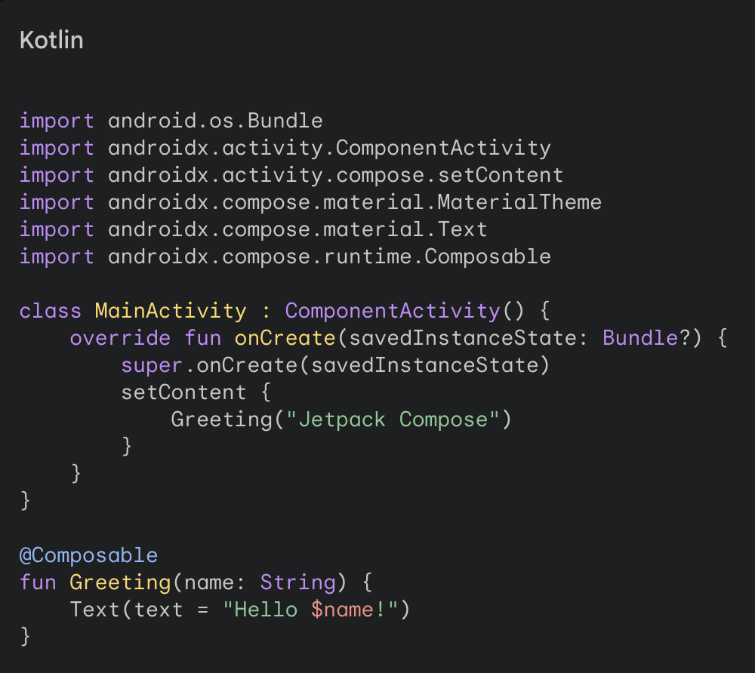
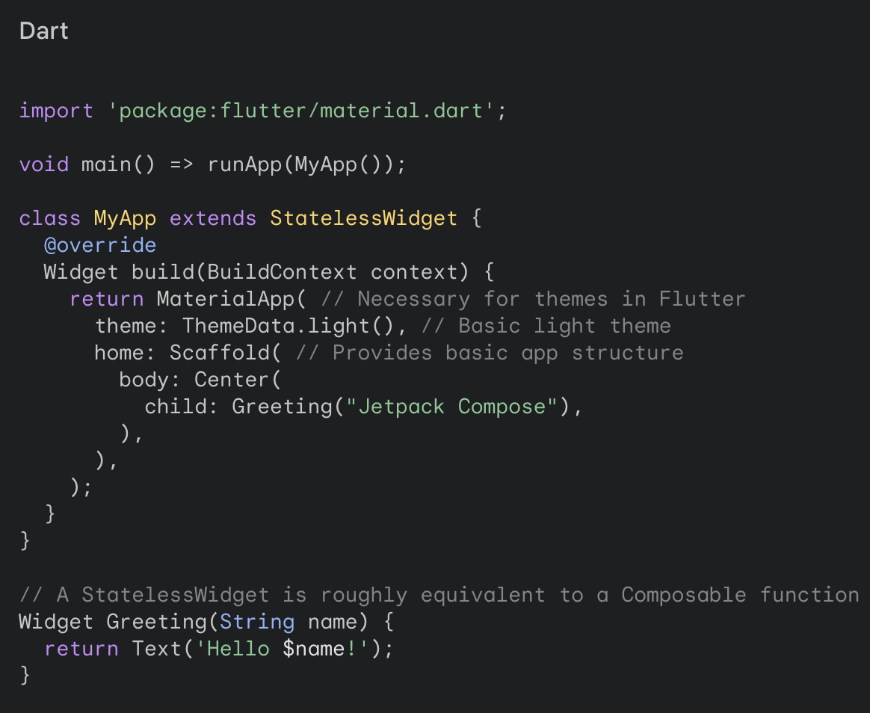
Notes:
play in band
riding horse
playing basketbal

Slide 8
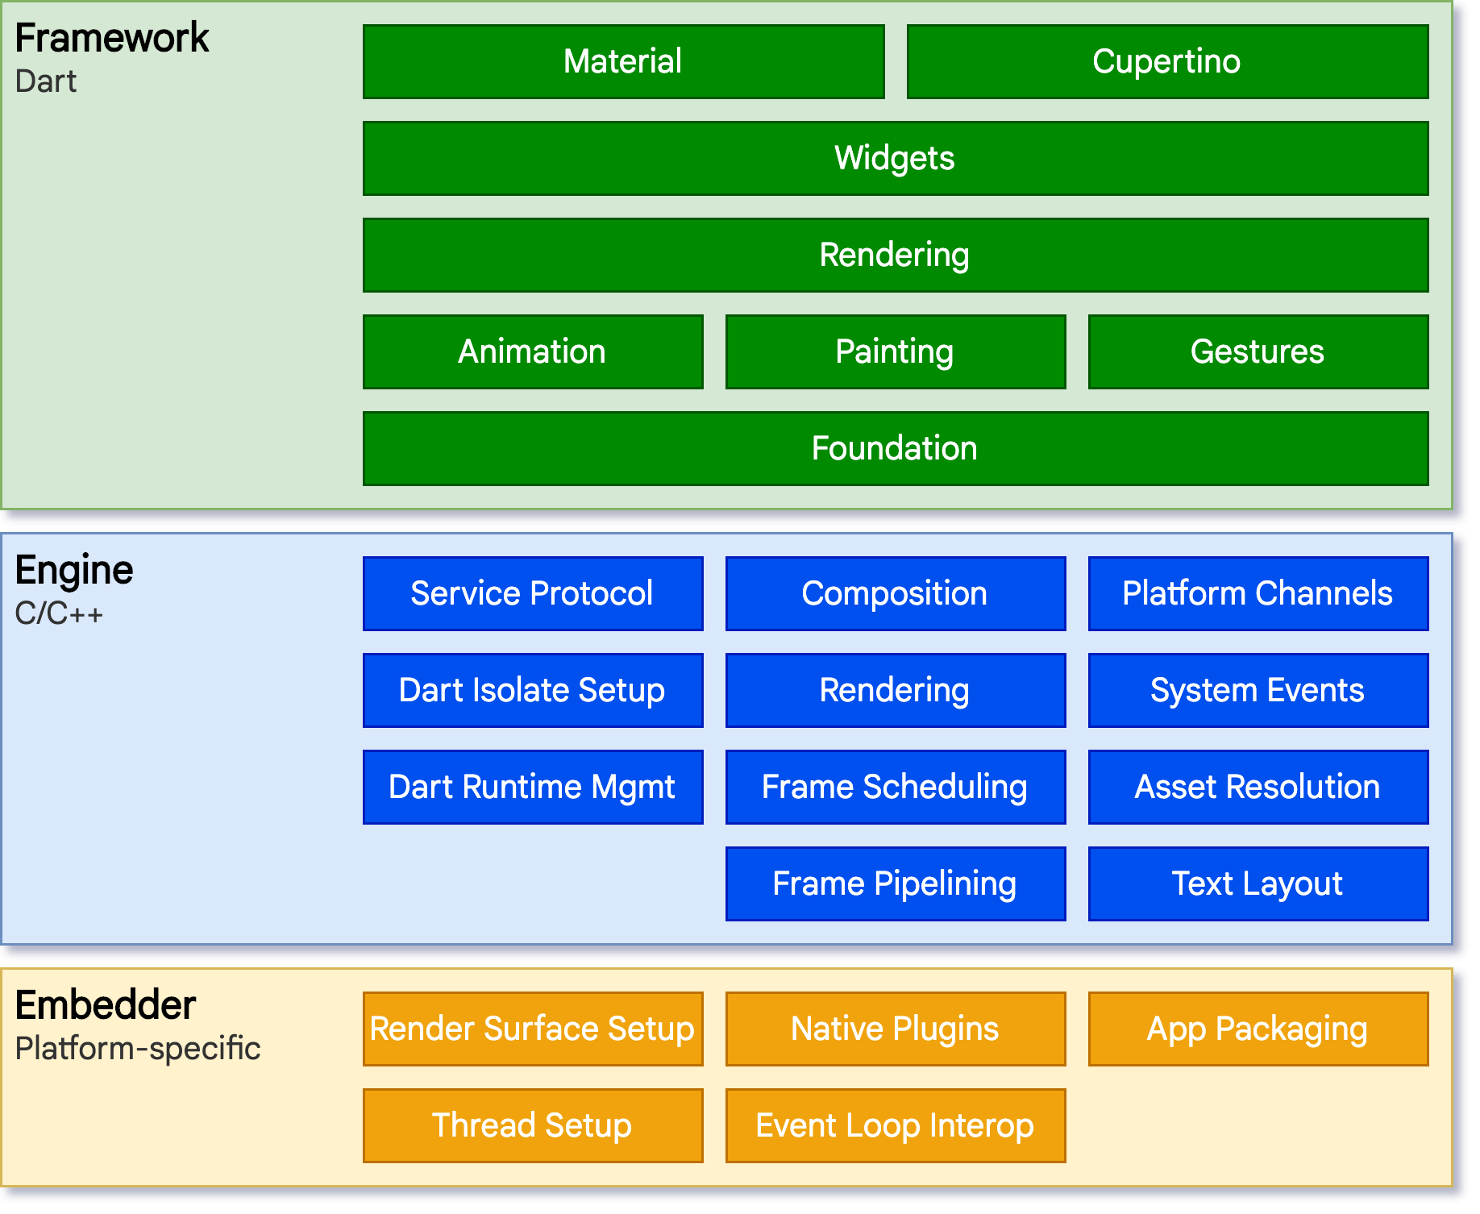
Hierarchy
Architecture layers
Anatomy of an app
Notes:
Dart App
Composes widgets into the desired UI.
Implements business logic.
Owned by app developer.
Framework (source code)
Provides higher-level API to build high-quality apps (for example, widgets, hit-testing, gesture detection, accessibility, text input).
Composites the app's widget tree into a scene.
Engine (source code)
Responsible for rasterizing composited scenes.
Provides low-level implementation of Flutter's core APIs (for example, graphics, text layout, Dart runtime).
Exposes its functionality to the framework using the dart:ui API.
Integrates with a specific platform using the Engine's Embedder API.
Embedder (source code)
Coordinates with the underlying operating system for access to services like rendering surfaces, accessibility, and input.
Manages the event loop.
Exposes platform-specific API to integrate the Embedder into apps.
Runner
Composes the pieces exposed by the platform-specific API of the Embedder into an app package runnable on the target platform.
Part of app template generated by flutter create, owned by app developer.

Slide 9
Why we are using Flutter
Small team
Small projects
Native-like performance
Beautiful UI
Notes:
Flutter lets your existing Android team deliver for iOS too, stretching your talent further. Your users won't notice it's not native code – Flutter looks and performs great. Designers will be thrilled by how easily their visions come to life. The development speed gains will transform how quickly your team can ship new features and updates.

Slide 10


Flutter
Introduction
Beginning
Notes:
l10n.yaml
arb-dir: lib/l10n/arb
template-arb-file: app_en.arb
output-localization-file: app_localizations.dart
nullable-getter: false

Slide 11
Flutter CLI
Create new Flutter projects: `flutter create`
Run app on emulators or device: `flutter run`
Build release versions: `flutter build`
Access testing tools: `flutter test`
Install and manage packages: `flutter pub get`
This is just basic.. find more by `flutter --help`.
Notes:
Command Line Input. CLI is a command line program that accepts text input to execute operating system functions. In the 1960s, using only computer terminals ...
The flutter command-line tool is how developers (or IDEs on behalf of developers) interact with Flutter. For Dart related commands, you can use the dart command-line tool.

Slide 12
widgets
Widgets are self-contained UI elements and everything in Flutter is a widget: button, text, image, layout, even the entire app.
Widgets form a hierarchical tree defining your app’s entire visual structure.
Widgets are declarative, describing what to display, not how to draw it.
Basics:
StatelessWidget
StatefulWidget
Notes:
Understanding widgets is the key to understanding Flutter. Every piece of your user interface, from the smallest piece of text to the overall layout of your app, is defined using widgets. Flutter takes a unique declarative approach: You describe the desired look of your UI using widgets, and Flutter handles the actual drawing efficiently. This makes it easier to think about designing user interfaces.

Slide 13
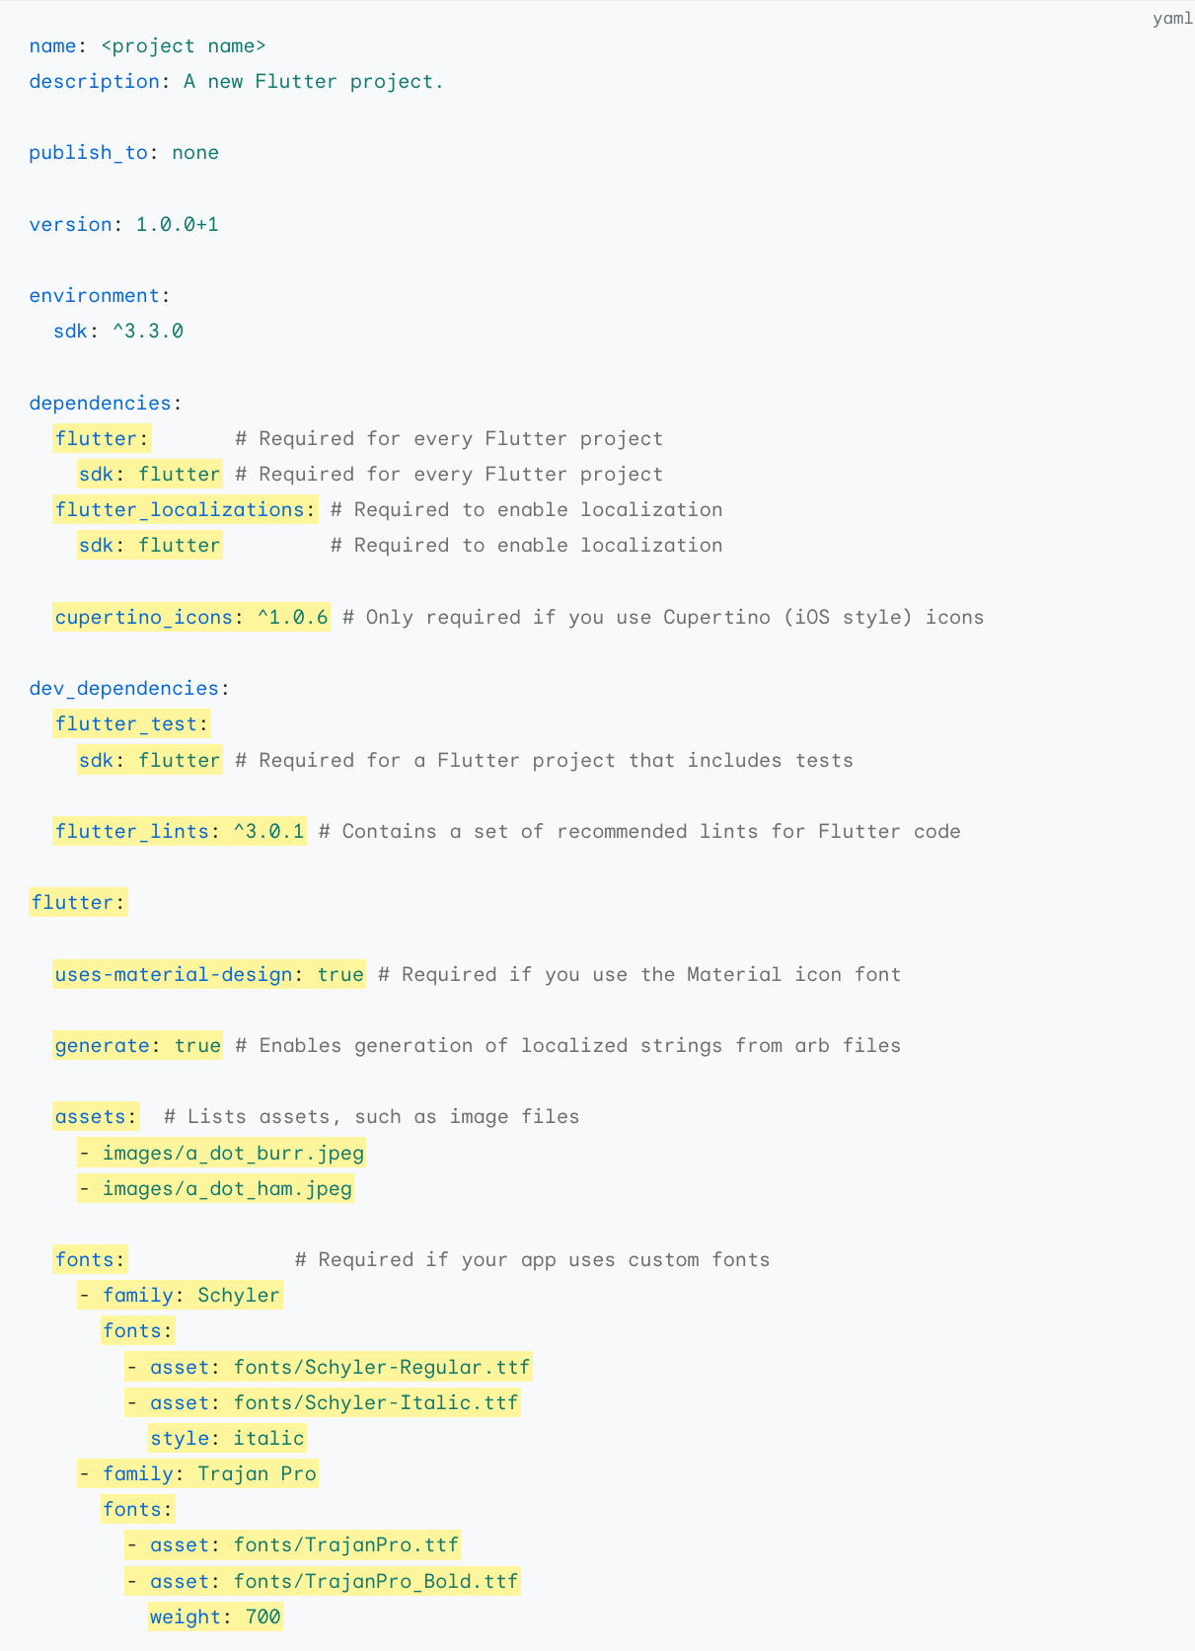
Pubspec.yaml
Project Metadata
name, description, version number, etc.
Dependencies
external flutter / dart packages your app relies on
Assets:
images, fonts, etc.
Notes:
The pubspec.yaml file acts as the control center for your Flutter project. It's where you define the name of your app, its fundamental information, the external libraries it needs, and the resources it uses. Think of it as the instruction manual that tells Flutter and the pub package manager how to build and run your app correctly.

Slide 14
Theme & ThemeData
The ThemeData class is where you define your theme's properties.
Customize colors: primaryColor, accentColor, etc.
Control typography: textTheme, fontFamily.
Set overall brightness: Brightness.light or Brightness.dark
Customize components: appBarTheme, buttonTheme, and more.
Notes:
ThemeData gives you granular control over how your app looks. It provides properties to set primary colors, fonts, the brightness of your theme, and even how individual components like app bars and buttons should be styled.
To use your custom theme, you'll usually start with a MaterialApp widget at the root of your app. The theme property of MaterialApp is where you provide your custom ThemeData. From this point on, widgets throughout your app will automatically inherit the styles you've defined.

Slide 15
Cupertino vs Material Design
Flutter uses Impeller rendering engine.
Material Design:
Google’s design system
Bold color scheme, realistic motion
Cupertino:
Apple’s iOS design language
Sleek aesthetics, depth cues
Notes:
Impeller provides a new rendering runtime for Flutter. The Flutter team's believes this solves Flutter's early-onset jank issue. Impeller precompiles a smaller, simpler set of shaders at Engine-build time so they don't compile at runtime.
Flutter gives you the incredible power to create apps that feel native to both Android and iOS. A key part of achieving this is choosing the design language that suits your target platform(s). Material Design is a natural fit for Android apps. It uses familiar visual cues and interaction patterns that Android users expect. Cupertino, on the other hand, is designed to make your Flutter app feel indistinguishable from a native iOS app. It follows Apple's Human Interface Guidelines and gives your app that characteristic iOS look and behavior.

Slide 16
Firebase
Firebase is a BaaS (Backend-as-a-Service) platform from Google.
Offers a suite of tools and services for easy app development.
Seamless integration with Flutter for streamlined development.
Key features:
App Check
App Distribution
Test Lab
Crashlytics
Messaging
Notes:
Firebase is a fantastic companion to Flutter app development. Firebase handles many common backend tasks and lets you focus on building amazing user interfaces with Flutter. This means you can develop full-fledged apps faster than ever, without having to build complex backend infrastructure.

Slide 17
Inherited Widget
Provides a way to share data from an ancestor widget
More efficient than directly passing data through constructors across multiple widget levels
Ideal for data that’s needed by a wide subtree
Notes:
Think of an InheritedWidget as a special box of information that can be placed high up in your Flutter widget tree. Widgets lower down in the tree can then easily reach into this box and grab the data they need, even if they aren't direct parent-child widgets. This avoids having to explicitly thread data down through many layers.
The magic is in the BuildContext. Every widget has a BuildContext, which is like its address within the widget tree. Flutter offers special functions on BuildContext that let descendant widgets query for InheritedWidget of a specific type further up the tree. Flutter's internal rendering system then optimizes how things are updated to avoid unnecessary rebuilds.
A common InheritedWidget use case is to manage app-wide themes. By changing the theme data held in the InheritedWidget, you can instantly trigger descendant widgets that rely on the theme to redraw themselves. This makes implementing things like a dark mode toggle very efficient.

Slide 18
State management - BLOC
State: The data that your app displays and reacts to (user input, fetched data, UI choices, etc.)
State Management: Predictably organizing, updating, and accessing the different parts of your app's state
Flutter Challenges: Widgets rebuild frequently, state can become scattered and difficult to manage as your app grows.
Building Scalable and Maintainable Apps
BLoC: Reactive State Management

Slide 19
Networking
Connect Your Flutter App to the World
The Built-in 'http' Package
Dio: Supercharged Networking for Flutter
Retrofit: Make it easy

Slide 20
Animations
Animations matter:
enhance user experience with visual cues and feedback
make interactions feel responsive and intuitive
add a touch of personality
Key concepts:
AnimationController: Manages the progress of the animation
Tween: Defines how a value changes during the animation
AnimatedWidget: Redraws itself when the animation value updates
Types of animation: Implicit, Explicit
Notes:
Animations have the power to transform your Flutter app from static to dynamic. Understanding how animations work in Flutter is key to creating engaging user experiences. Implicit animations are the perfect way to start quickly adding subtle effects to your UI. As you want more control and customization, explicit animations provide the tools to choreograph complex, eye-catching motion. Remember that animations should always serve a purpose, whether it's providing user feedback, aiding understanding, or simply adding that extra bit of delight!

Slide 21
Keys
Keys provide unique identifiers for widgets within a widget tree.
Help Flutter preserve the state of widgets when they move around in the widget tree.
Let Flutter know which widgets need rebuilding, minimizing unnecessary work.
Key types:
ValueKey
ObjectKey
UniqueKey
Notes:
ValueKey: Useful when your widget list content is predictable.
ObjectKey: Suitable for dynamic data where order can change.
UniqueKey: Generates a new random key every rebuild. (Caution: overuse can hurt performance)
Think of keys as nametags for your widgets. While widgets might look the same, Flutter uses keys to distinguish between them, especially when things get rearranged in your UI. Properly using keys helps Flutter be incredibly efficient when updating the screen, which is crucial for a smooth user experience, especially in apps with complex or dynamic layouts.

Slide 22
ISOLATES
Isolates are like mini-threads within your Flutter app.
Run code independently, with their own memory space.
Ideal for:
CPU-intensive tasks (image processing, complex calculations)
Long-running operations that might freeze the UI
Background tasks that shouldn't be interrupted

Slide 23
Platform Bridge
Platform channels enable communication between Flutter's Dart code and platform-specific code (Java/Kotlin on Android, Objective-C/Swift on iOS).
Essential for accessing:
Device features not exposed by default (camera, sensors, etc.)
3rd-party SDKs written in native code.
Performance-critical code that's better suited to native languages.

Slide 24
Testing
Testing is fundamental to developing high-quality Flutter apps that function reliably.
Type of tests:
Unit Tests
Widget Tests
Integration Tests
Golden Tests

Slide 25
Flutter
Introduction
Q&A
Notes:
l10n.yaml
arb-dir: lib/l10n/arb
template-arb-file: app_en.arb
output-localization-file: app_localizations.dart
nullable-getter: false

Slide 26


Audience Q&A Session
ⓘ Start presenting to display the audience questions on this slide.

Slide 27

Flutter
Introduction
That’s all folks
Notes:
Jake Wharton
Donn Felker
Filip Hráček

Slide 28
Mason
Mason is a code generation tool
Generate anything
Boosts Productivity
Enforces Consistency
Notes:
Content
Mason is a code generation tool: Build reusable templates called 'bricks'.
Generate anything: Files, folders, full features – write the template once, use it anywhere.
Boosts Productivity: Automate repetitive coding tasks
Enforces Consistency: Standardizes code structure across your project (or team).
Speaker Notes: Mason is like a super helpful butler for your Flutter development. Imagine needing to create a new feature, and it involves setting up multiple files, writing boilerplate code, etc. With Mason, you create a 'brick' (template) for that feature. Then, anytime you need that feature, Mason generates all the customized code for you! This saves loads of time and ensures things are done in the same way every time.
https://brickhub.dev/bricks/very_good_core/0.6.1#usage

Slide 29
Environments and Certificates
Distinct Configurations
Environment-Specific Values
Build Variants / Flavors
Simplify Switching
Notes:
Distinct Configurations: Have separate configurations for each environment.
Environment-Specific Values: Utilize different API base URLs, feature flags, logging levels, etc., depending on the environment.
Build Variants/Flavors: Create build variants (flavors) to generate separate app versions for each environment.
Simplify Switching: Make environment switching easy for streamlined development and testing.
Setting up distinct environments allows you to tailor your Flutter app's behavior appropriately. Development environments might connect to test servers, have more debugging information, and potentially enable experimental features. Staging environments are used for rigorous testing and mimic production as closely as possible. Production environments point to live APIs, have optimized code, and may have stricter error handling. Clearly defined and easy-to-manage environments are vital for a smooth development and release process.

